Slide 1

Business Insights from Namma Yatri Trip Data
Enabling Strategic Decisions through Data
Names:- Shubham Dhar , Smita R Nidavani , Sushant Salunke

Slide 2
Agenda
Objective
Preview
Key Insights
Strategic Recommendations
Appendix
Summary of Actions

Slide 3
Objective
Reduce Trip cancellation Rate
Utilising Resources effectively to increase Revenue.
To focus on improvement areas to increase customer satisfaction.

Slide 4
Preview
Revenue peaks identified during non-obvious hours (12PM–3PM, 12AM–3AM)
Utilising Top zones (e.g., Mahadevapura, Bangalore South) drive volume and value
High cancellation rates suggest driver allocation & incentive challenges

Slide 5
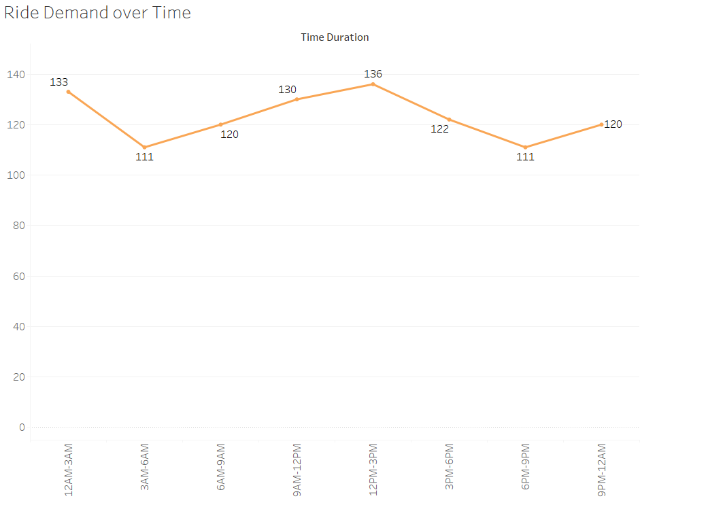
Key Insights I – Actual peak Hours not Peaky
Peak hours are obtained during mid – night & Mid – day.
Demand is steady with dips early morning; opportunity to boost rides during mildly busy hours (12–3 PM).

Slide 6
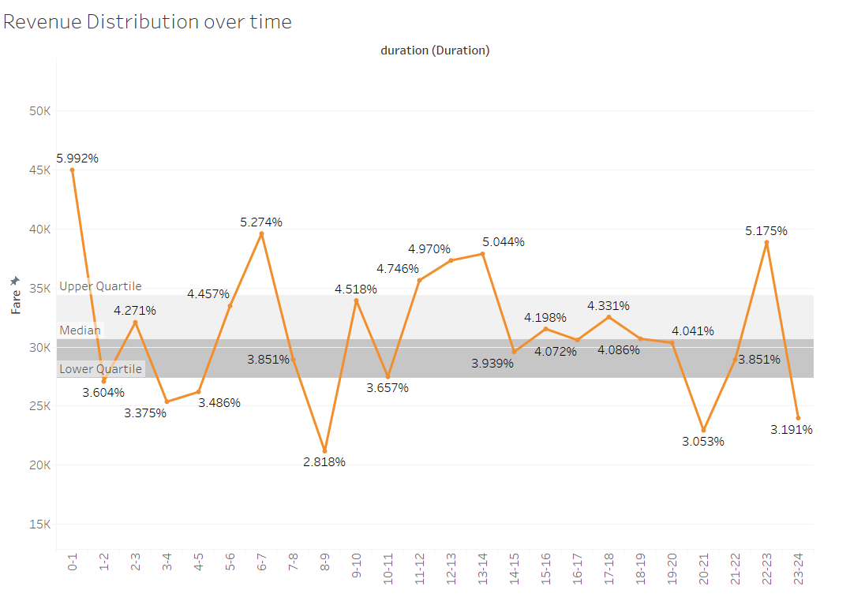
Key Insights II – Lowest Revenue During Peak hour
During 8-9AM lowest 2.88% Revenue of overall.
During 12PM-1AM highest 5.99% Revenue of overall.
Decision point: Explore pricing strategies or targeted driver coverage during these hours.

Slide 7
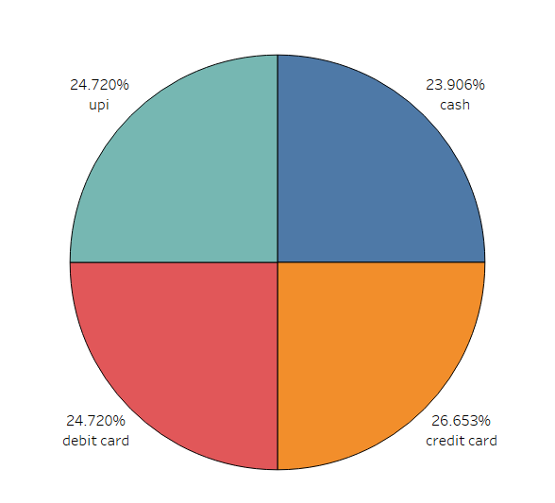
Key Insights III – Promote UPI for cost Saving
Credit Card (26.65%) is dominant
Suggestion: Ensure seamless experience for top methods; promote UPI for cost-saving

Slide 8
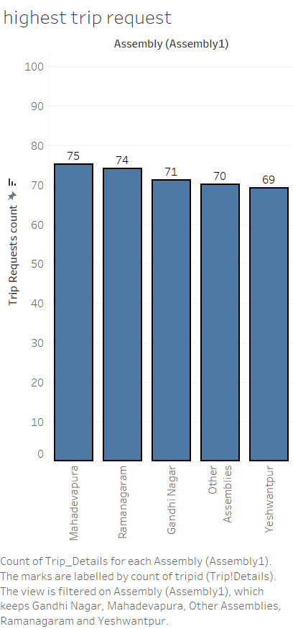
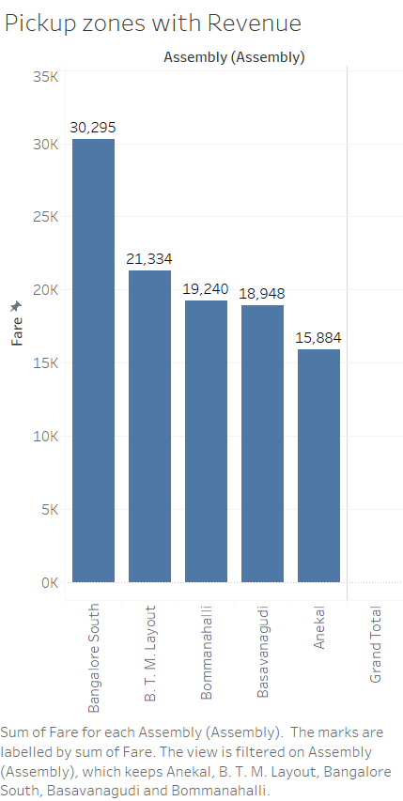
Key Insights IV – High Performing Zones
Top Zone by Trip value – Mahadevapura
Top Zone by Revenue – Bangalore South
Suggestion: Prioritize driver distribution and targeted promotions in these areas

Slide 9
Key Insights V – 47-48% Cancellation
Nearly 47–48% cancellation → Operational gap → lost revenue
Recommendation : Focused driver training or incentives to reduce cancellation + customer assurance initiatives
 | For Drivers | For Customer
Successful Rides | 52.75% | 51.83%
Cancelled Rides | 47.25% | 48.17%

Slide 10
Strategic Recommendations
Operational: Allocate more drivers during high-fare but low-trip hours
Geographical: Prioritize high-performing zones for incentives
Revenue: Dynamic pricing during top-revenue hours
Customers: Reduce cancellations through better ETA prediction and Discounts.

Slide 11
Summary of Actions
Focus Area | Action | Outcome
Peak Revenue Hours | Boost driver supply | More completed rides
High Cancellation Zones | Incentivize Completion | Revenue Protection
Bangalore South | Regional Offers | Max Revenue Potential
UPI Push | Marketing | Payment cost optimization

Slide 12
Appendix
Data Used:-
Duration Table – Consist Trip Booking Duration
Assembly Table – Consist locations of Bookings
Payment – Consist information about Payment types
Trip Details – Consist Information about completed & non-completed Trips
Trip – Consist information about completed Trips

Slide 13
Thank You

